Slide 1

COronaVIrus Disease 2019
A PREDICTION OF THINGS TO COME
CHAN DOMINIC
- DSI13 -

Slide 2
01
04
BACKGROUND
EDA
02
05
TABLE OF CONTENTS
PROBLEM STATEMENT
PREDICTIONS
03
06
THE DATA
CONCLUSIONS

Slide 3

01 BACKGROUND
In January 2020, a novel coronavirus, SARS-CoV-2, was identified as the cause of an outbreak of viral pneumonia in Wuhan, China. The disease, later named coronavirus disease 2019 (COVID-19), subsequently spread globally. In the first three months after COVID-19 emerged nearly 1 million people were infected and 50,000 died.
Similar to the severe acute respiratory syndrome (SARS) and Middle East respiratory syndrome (MERS) of the past.

Slide 4

01 BACKGROUND
MERS is a viral respiratory disease that was first reported in Saudi Arabia in September 2012 and has since spread to 27 countries. From its emergence through January 2020, WHO confirmed 2,519 MERS cases and 866 deaths (about 1 in 3).
Infection with SARS coronavirus (SARS-CoV) can cause a severe viral respiratory illness. SARS was first reported in Asia in February 2003, though cases subsequently were tracked to November 2002. SARS quickly spread to 26 countries before being contained after about four months. More than 8,000 people fell ill from SARS and 774 died. Since 2004, there have been no reported SARS cases.

Slide 5

02
PROBLEM STATEMENT
Determining the significance of variables to accurately predict the global COVID-19 cases; to effectively predict their eventual progression of deaths and cases by means of the Regression models. This is to ensure that global citizens are made aware to the situation's progression and can make the necessary preparations should there be an extended lockdown period. Goverenments and private companies can leverage on this model to make a informed decision as to growth of the economy and businesses.

Slide 6






03 ABOUT THE DATA
SG RELATED DATA
GLOBAL SOURCE
COMPETITION WEEK 4
co.vid19.sg provided detailed information of the individual cases up till 19 April 20
Dataset operated by the Johns Hopkins University Center for Systems Science and Engineering and was updated daily. This was also the source to the Kaggle dataset
The challenge involves forecasting confirmed cases and fatalities between April 15 and May 14. Training set contain features from prior.

Slide 7
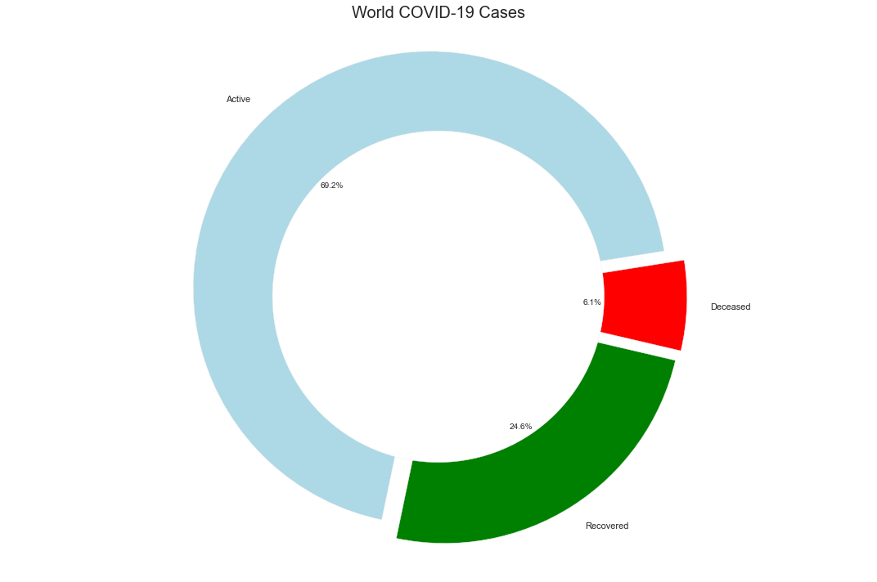
DEATHS
ACTIVE CASES
04 EXPLORATORY DATA ANALYSIS
RECOVERED
197,004
2,217,912
789,069

Slide 8
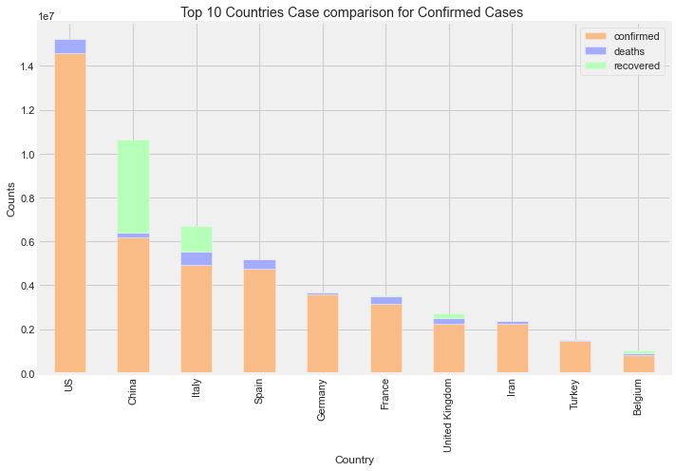
04 EXPLORATORY DATA ANALYSIS

Slide 9
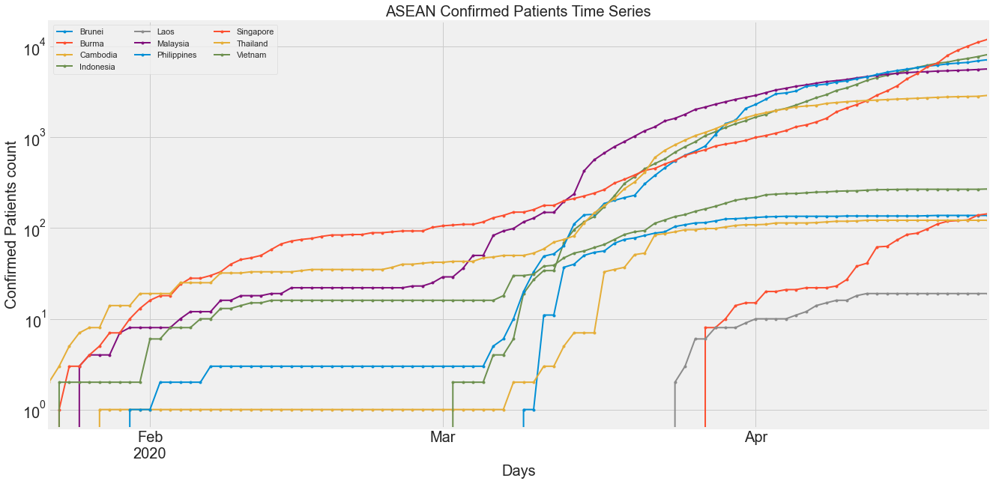
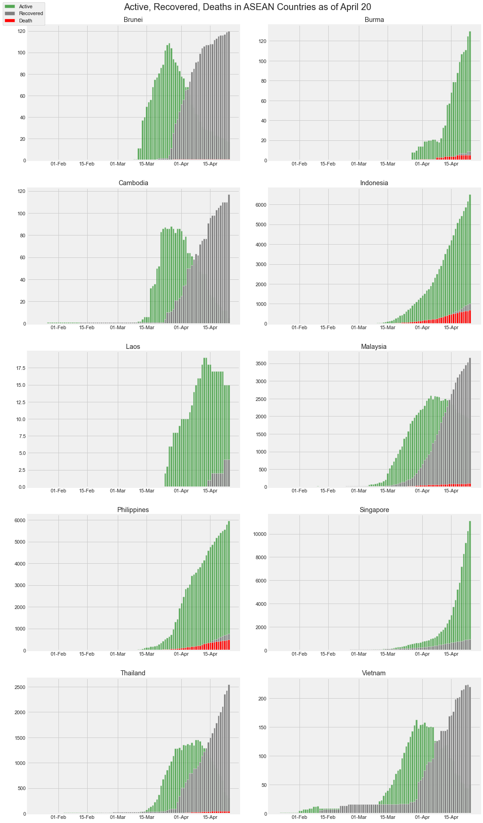
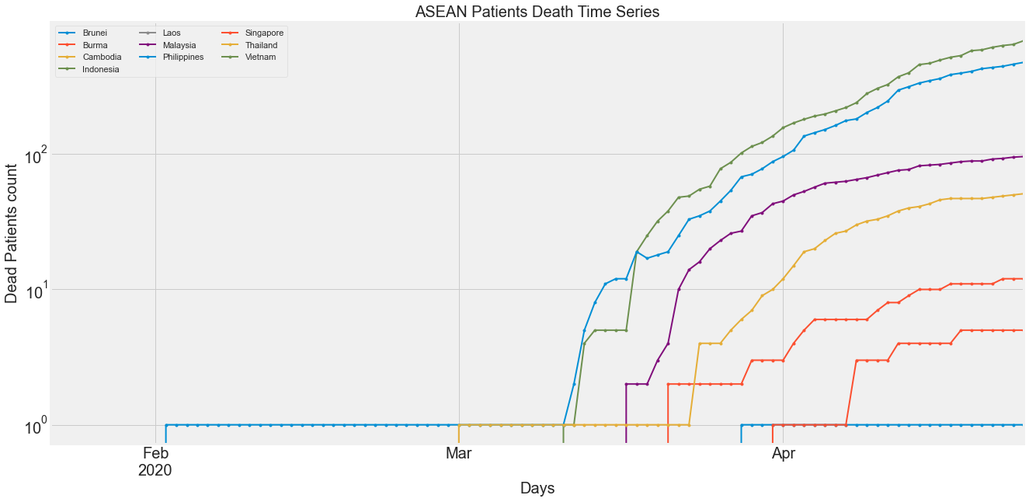
04 EXPLORATORY DATA ANALYSIS

Slide 10
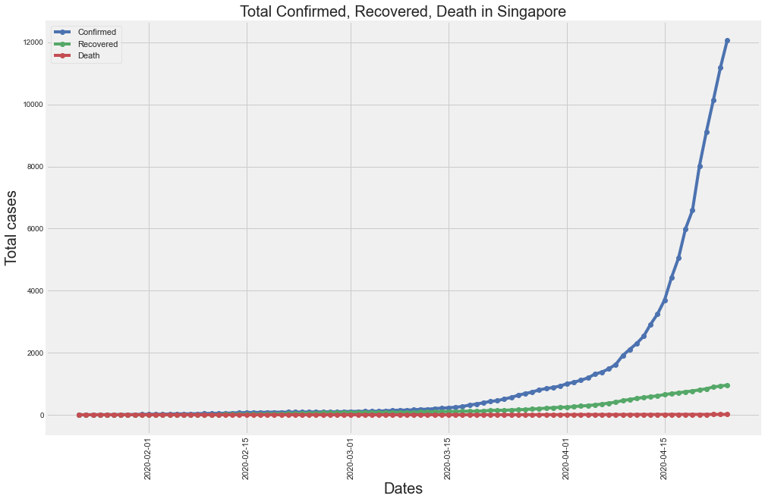
04 EXPLORATORY DATA ANALYSIS

Slide 11
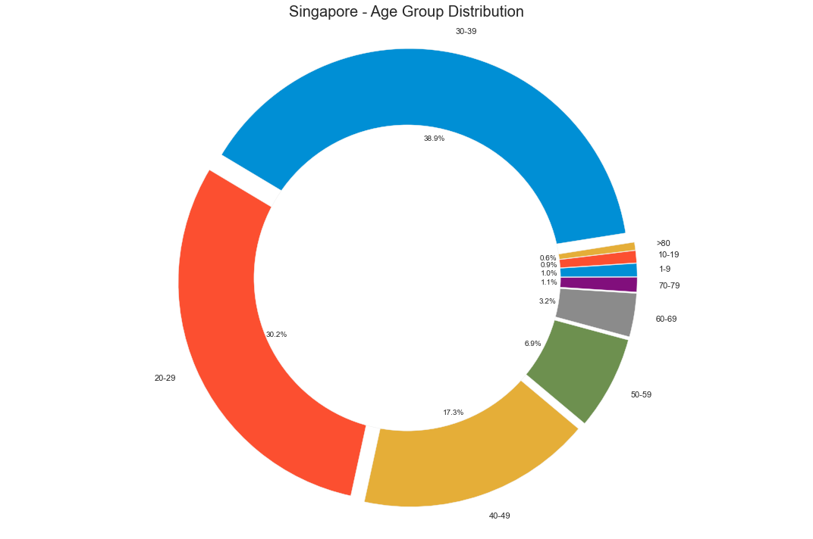
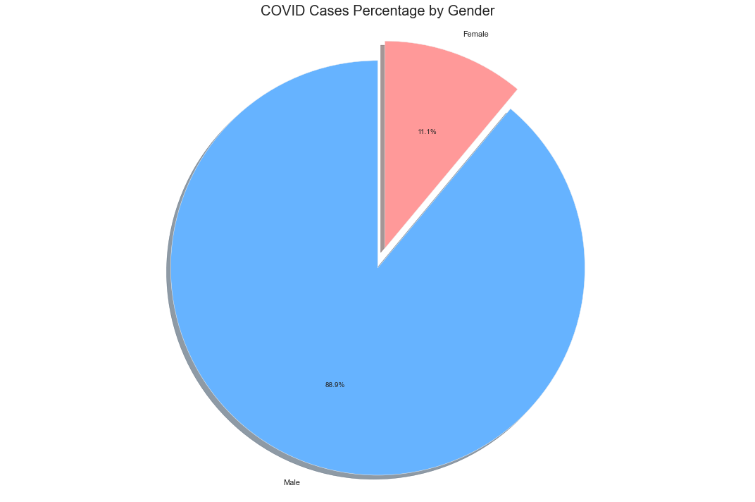
04 EXPLORATORY DATA ANALYSIS

Slide 12
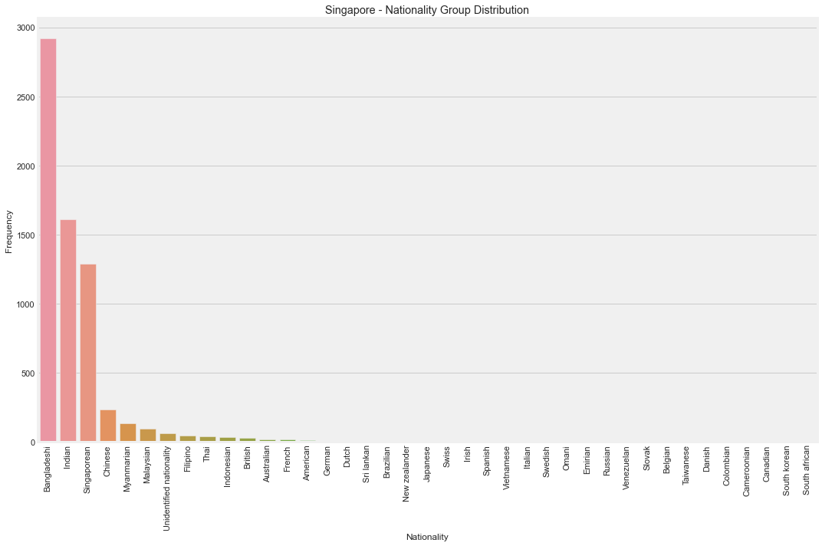
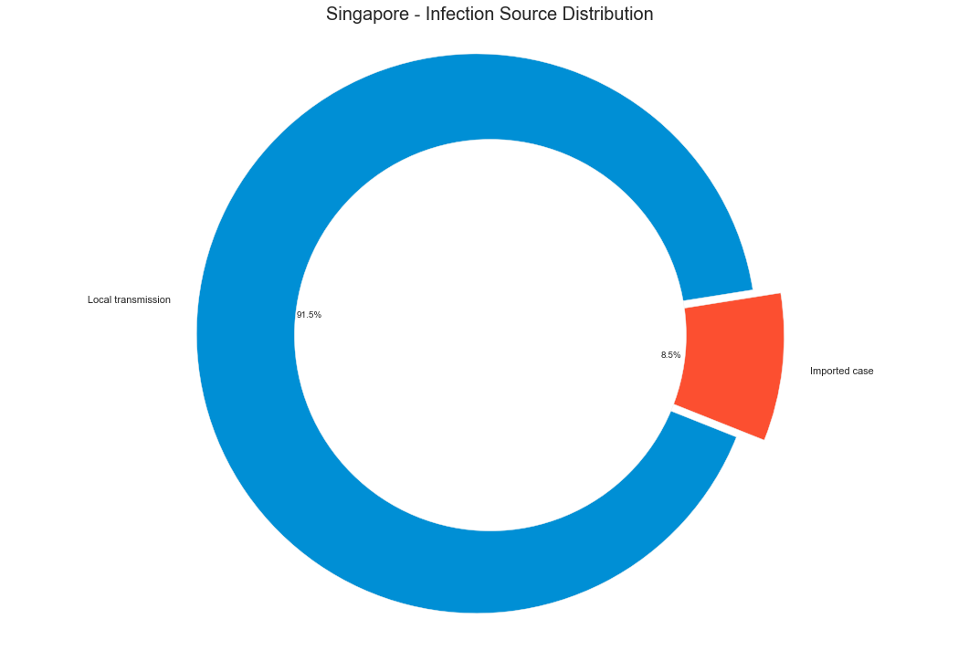
04 EXPLORATORY DATA ANALYSIS

Slide 13



05 PREDICTIONS
LINEAR REGRESSION
RANDOM FOREST
XGBOOST
For scraped data, the linear regression model performed the worst on the training set,, though it performed the best on the validation set.
For Kaggle dataset, linear regression was significantly the worst performing model.
For scraped data, the RF model performed average on the training set, though it performed worst on the validation set.
For Kaggle dataset, RF was the best perform model.
For scraped data, the XGB model performed best on the training set, though it displayed average performance on the validation set.
For Kaggle dataset, XGB was the 2nd best performing model.

Slide 14
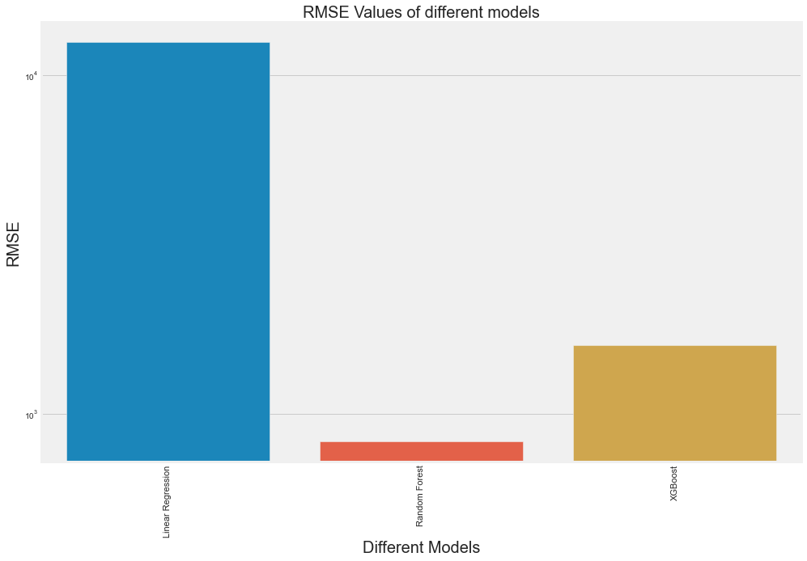
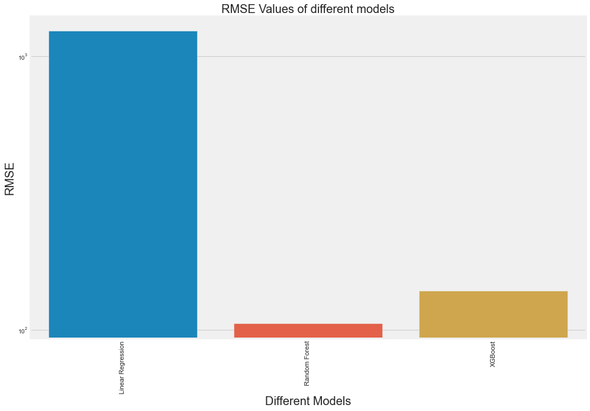
05 PREDICTIONS
ConfirmedCases
Fatalities
model | mse | rmse
Linear Regression | 157470458.21 | 12548.72
Random Forest | 687457.82 | 829.13
XGBoost | 2543786.22 | 1594.93
model | mse | rmse
Linear Regression | 1529577.74 | 1236.76
Random Forest | 11173.06 | 105.7
XGBoost | 19406.37 | 139.31

Slide 15
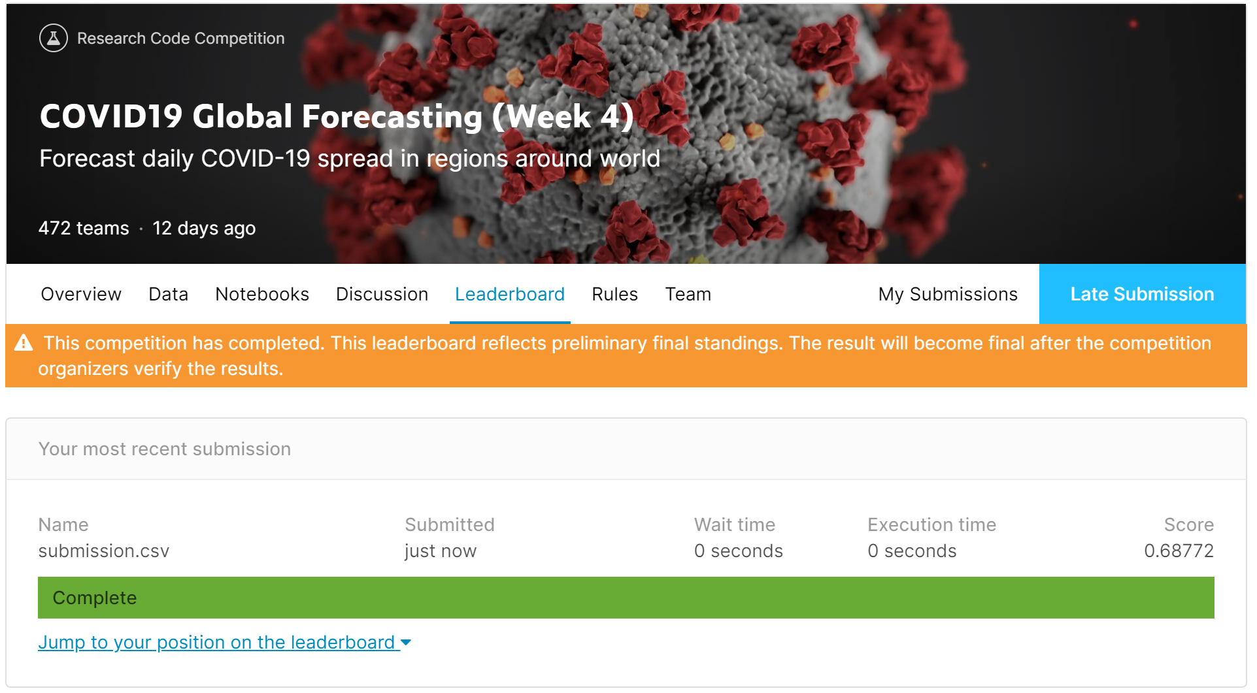
05 PREDICTIONS

Slide 16

WHAT YOU SHOULD DO
RECOMMENDATIONS
Recommendation
The model can serve as a prediction model for countries and businesses. Additionally, citizens can be more discerning of the potential for number of cases and deaths to rise (or fall) with time.
Notwithstanding this, more data, as mentioned above, will serve to optimise the model. The model can also serve as a starting point, to be extrapolated to individual countries with additional research to be done marrying the features together.
The current datasets have very little features to work with which led to me breaking up the datetime aspects of it to be used as engineered features.
The data could be supplemented with additional features like weather info, public transport info, global events with participation rates and locations (i.e. music festivals/olympics).

Slide 17
THANKS!
Does anyone have any questions?
domchanjl@gmail.com
+65 8112 7772
yourcompany.com

Slide 18
RESOURCES
https://github.com/CSSEGISandData/COVID-19
https://co.vid19.sg/singapore/dashboard.
https://www.niaid.nih.gov/diseases-conditions/covid-19

